Slide 1

Chapter 22
Network Layer:
Delivery, Forwarding, and Routing
Copyright © The McGraw-Hill Companies, Inc. Permission required for reproduction or display.

Slide 2
22-1 DELIVERY
The network layer supervises the handling of the packets by the underlying physical networks. We define this handling as the delivery of a packet.
Topics discussed in this section:
Direct Versus Indirect Delivery

Slide 3
Direct delivery occurs when a packet is to be delivered to a destination in the same network OR from the last router
Indirect delivery occurs when the packet is to be delivered to a destination in a different network.

Slide 4
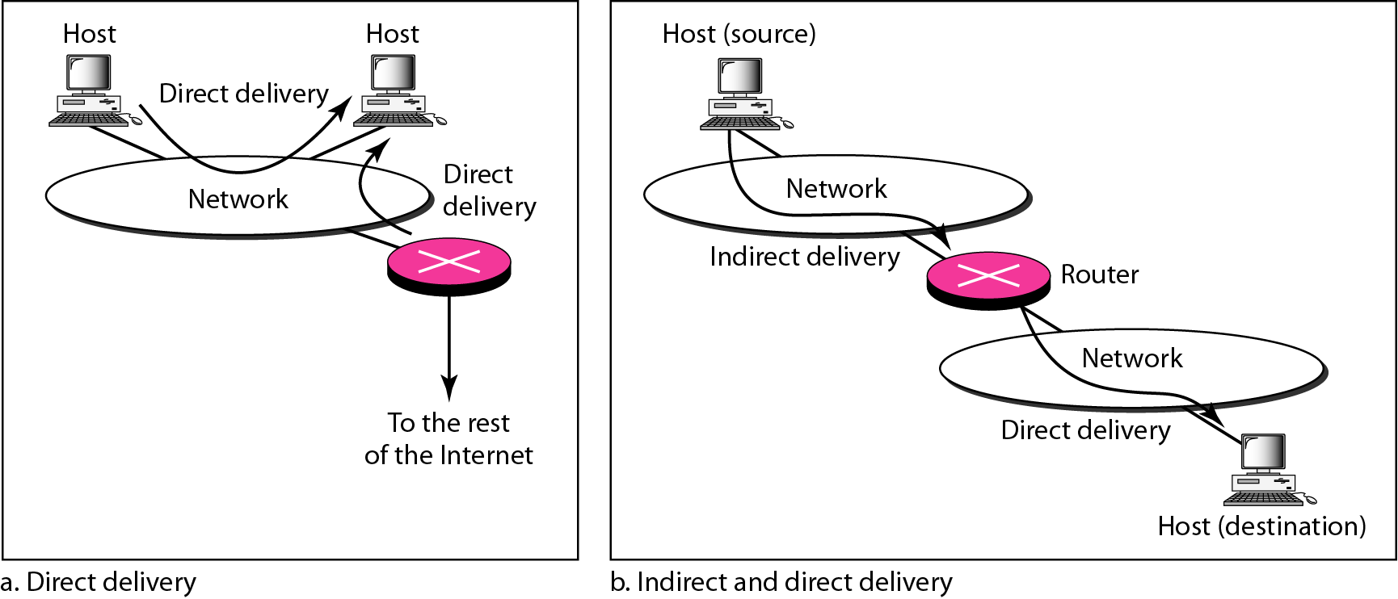
Figure 22.1 Direct and indirect delivery

Slide 5
22-2 FORWARDING
Forwarding means to place the packet in its route to its destination. Forwarding requires a host or a router to have a routing table. When a host has a packet to send or when a router has received a packet to be forwarded, it looks at this table to find the route to the final destination.
Topics discussed in this section:
Forwarding Techniques Forwarding Process
Routing Table

Slide 6
Next hop method the routing table holds only the address of the next hop

Slide 7
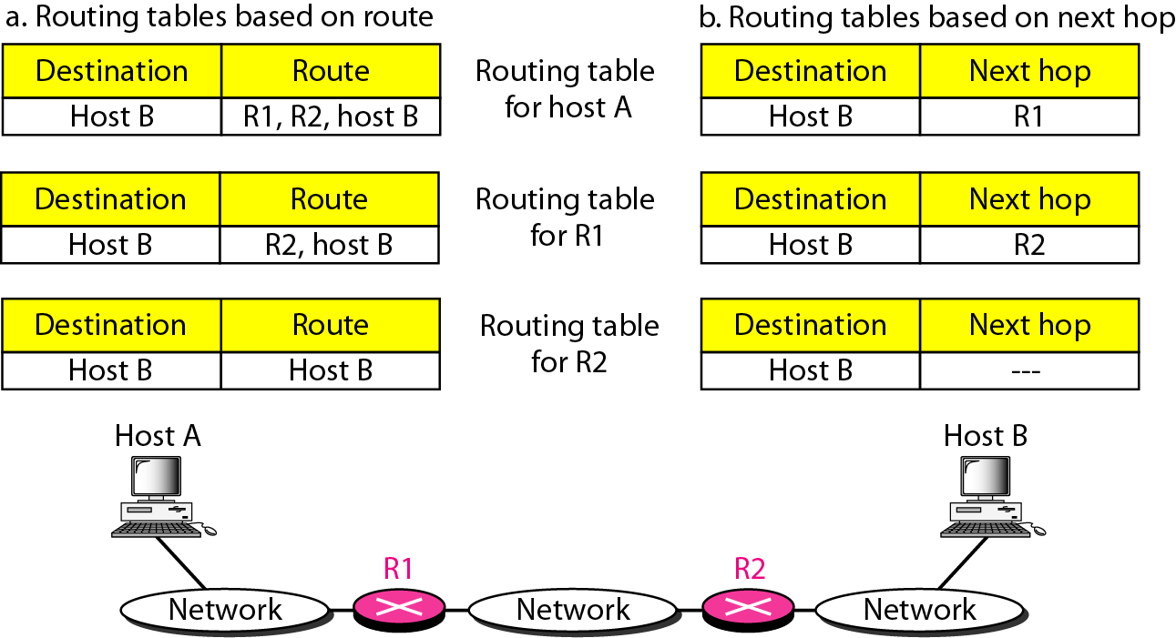
Figure 22.2 Route method versus next-hop method

Slide 8
Network specific method uses one entry that defines the address of the destination network itself (e.g. 1000 hosts are attached to the same network only one entry exists in the routing table instead of 1000)

Slide 9
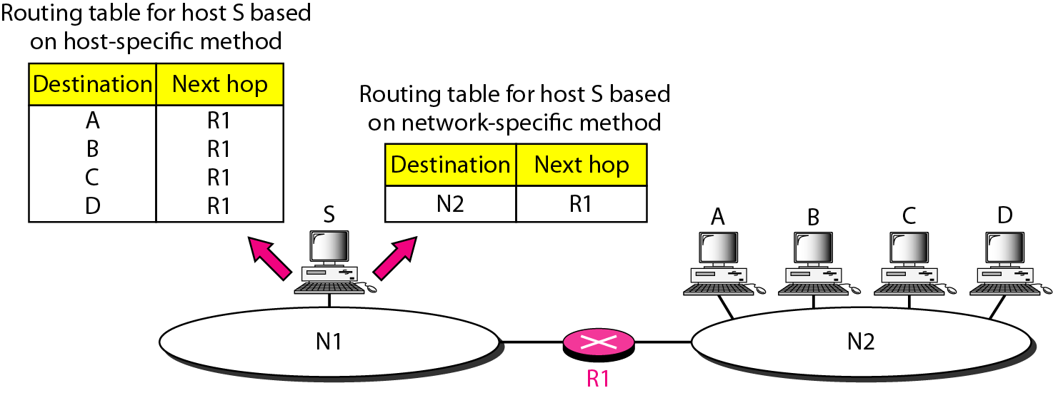
Figure 22.3 Host-specific versus network-specific method

Slide 10
Default method routes packets either to a specific network using one router or to the default router that routes all other packets to the rest of the internet
Default address is 0.0.0.0

Slide 11
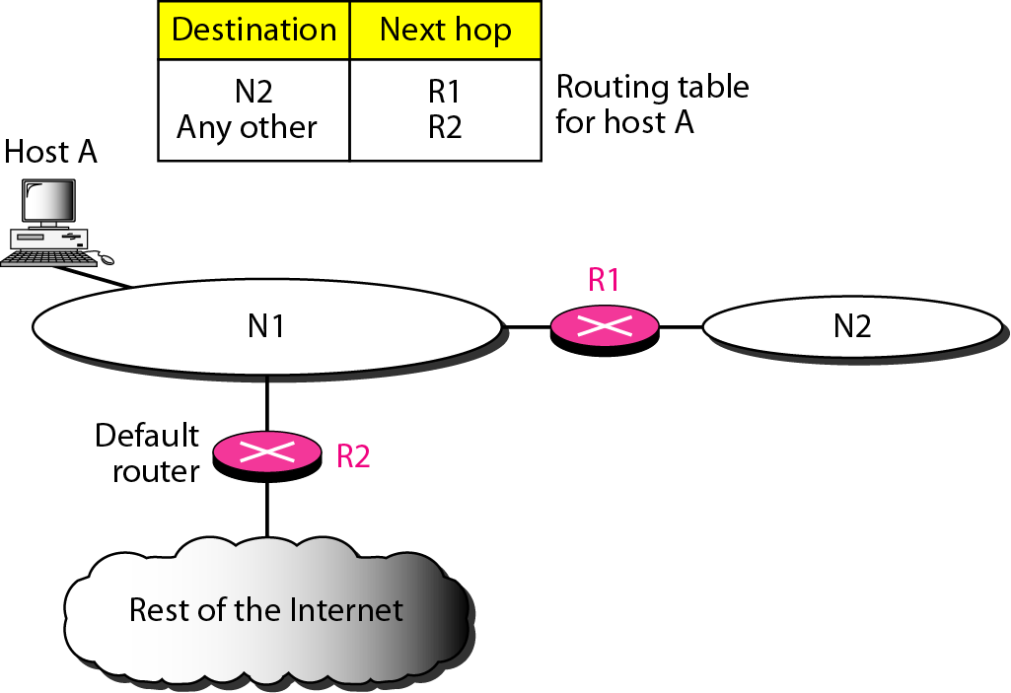
Figure 22.4 Default method

Slide 12
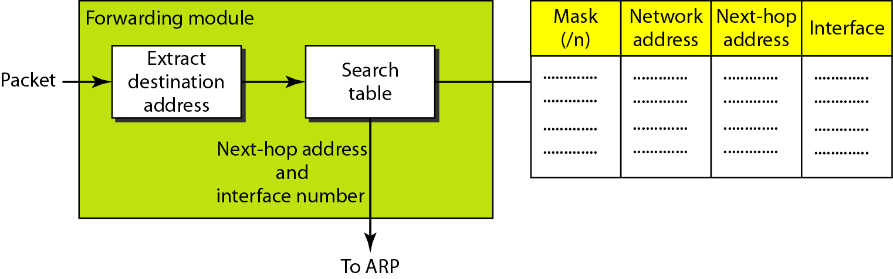
Figure 22.5 Simplified forwarding module in classless address

Slide 13

Note
In classless addressing, we need at least four columns in a routing table.

Slide 14
Example 22.1
Make a routing table for router R1, using the configuration in Figure 22.6.
Solution
Table 22.1 shows the corresponding table.

Slide 15
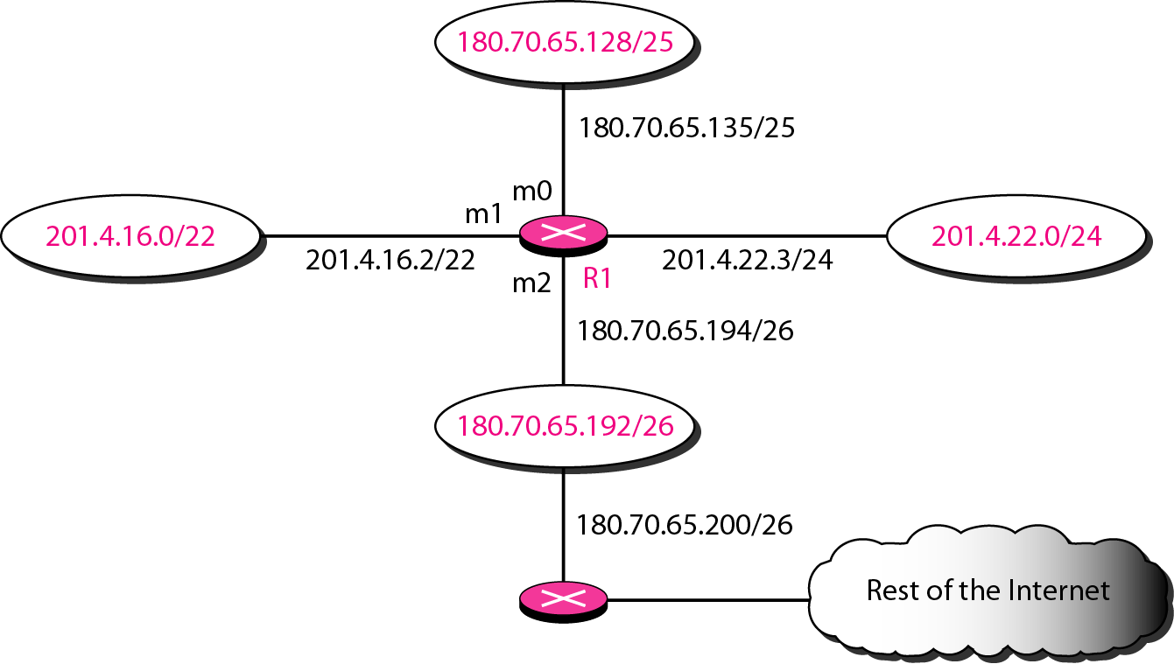
Figure 22.6 Configuration for Example 22.1

Slide 16
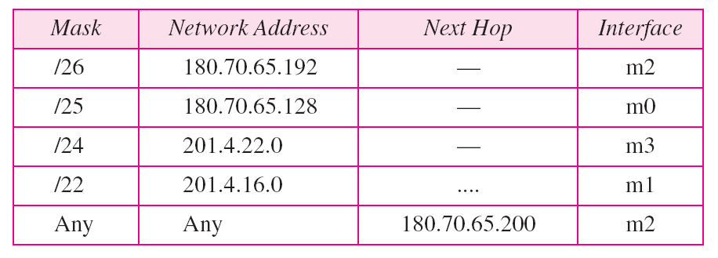
Table 22.1 Routing table for router R1 in Figure 22.6

Slide 17
Example 22.2
Show the forwarding process if a packet arrives at R1 in Figure 22.6 with the destination address 180.70.65.140.
Solution
The router performs the following steps:
1. The first mask (/26) is applied to the destination address. The result is 180.70.65.128, which does not match the corresponding network address.
2. The second mask (/25) is applied to the destination address. The result is 180.70.65.128, which matches the corresponding network address. The next-hop address and the interface number m0 are passed to ARP for further processing.

Slide 18
Example 22.3
Show the forwarding process if a packet arrives at R1 in Figure 22.6 with the destination address 201.4.22.35.
Solution
The router performs the following steps:
1. The first mask (/26) is applied to the destination address. The result is 201.4.22.0, which does not match the corresponding network address.
2. The second mask (/25) is applied to the destination address. The result is 201.4.22.0, which does not match the corresponding network address (row 2).

Slide 19
Example 22.3 (continued)
3. The third mask (/24) is applied to the destination address. The result is 201.4.22.0, which matches the corresponding network address. The destination address of the packet and the interface number m3 are passed to ARP.

Slide 20
Example 22.4
Show the forwarding process if a packet arrives at R1 in Figure 22.6 with the destination address 18.24.32.78.
Solution
This time all masks are applied, one by one, to the destination address, but no matching network address is found. When it reaches the end of the table, the module gives the next-hop address 180.70.65.200 and interface number m2 to ARP. This is probably an outgoing package that needs to be sent, via the default router, to someplace else in the Internet.

Slide 21
Address aggregation is used to alleviate the problem of growing router tables
Idea is that one router deals with organizational routing or other large group routing while another router sends all packets belonging to the organization or other large group of networks using the same table entry and all others to the internet

Slide 22
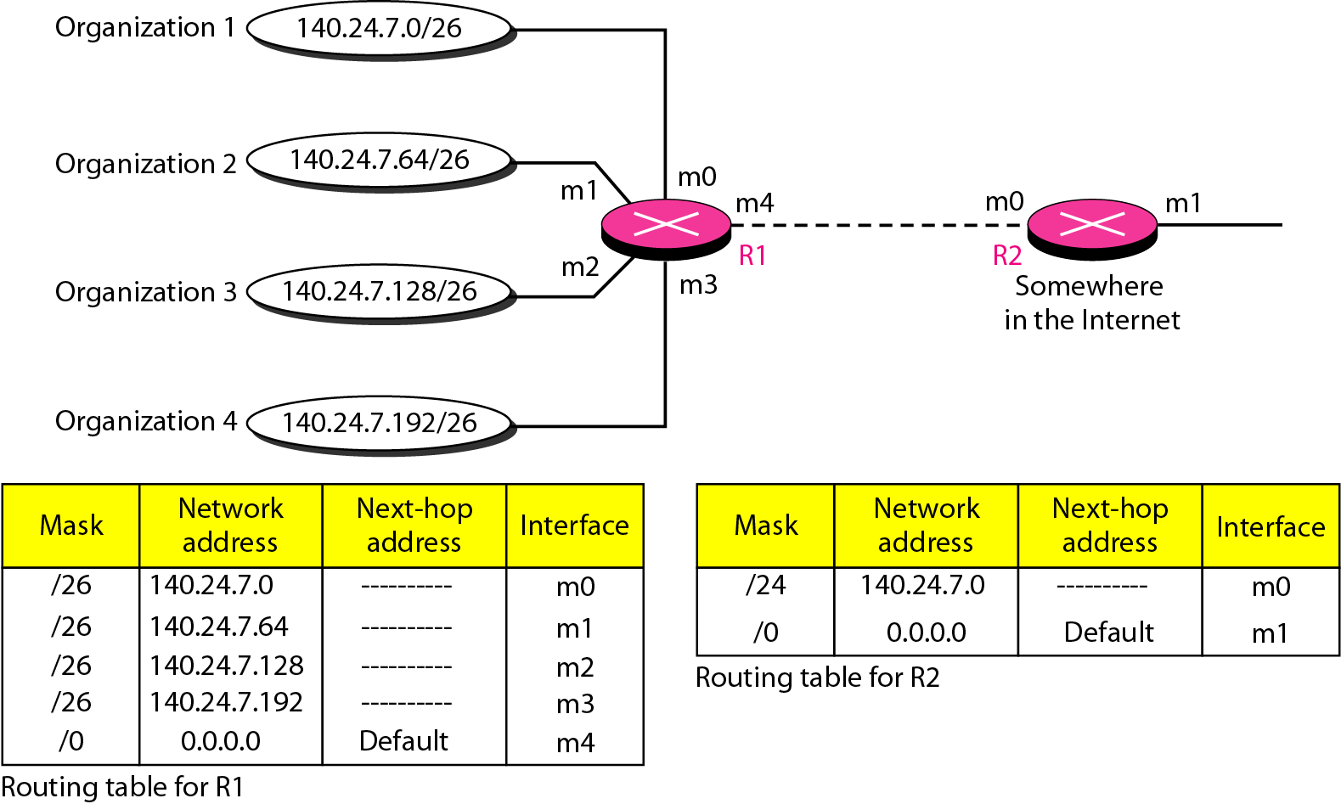
Figure 22.7 Address aggregation

Slide 23
Longest mask matching allows group networking that are not geographically close to each other
Routing tables sort the table by the longest to shortest mask value
E.g. examine fig. 22.8. Suppose a packet arrives for organization 4 to router R2 with destination address 140.24.7.200. The first mask at router R2 is applied, which gives the network address 140.24.7.192. The packet is routed correctly. If the masks were not in order, e.g. /24 was applied first, the packet would not be routed correctly

Slide 24
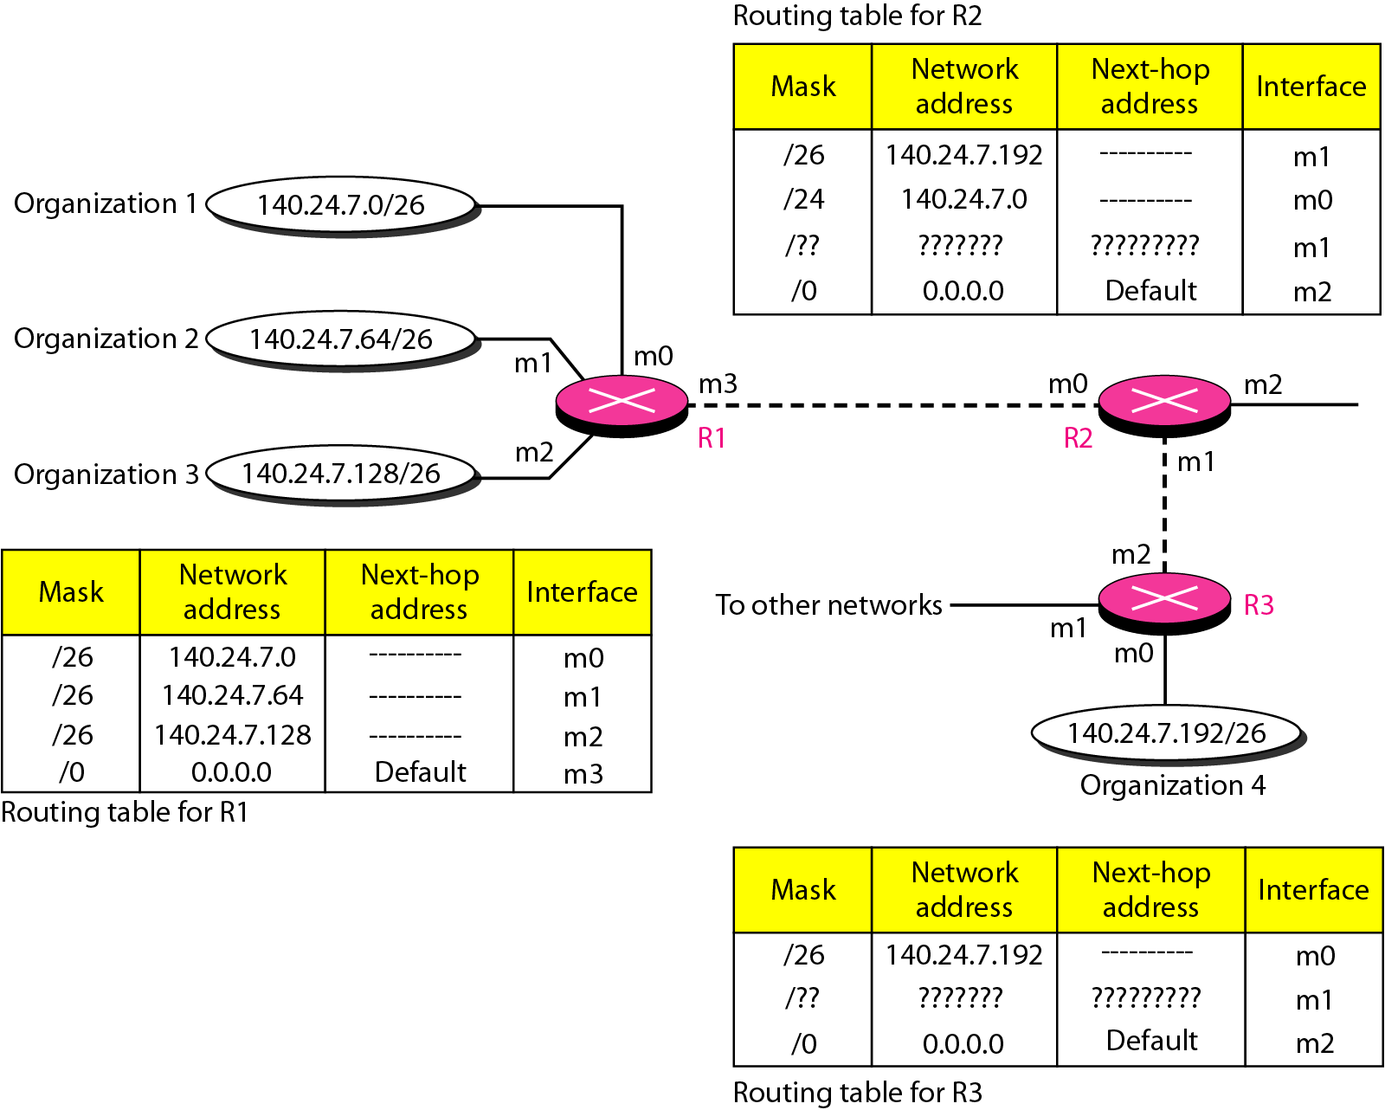
Figure 22.8 Longest mask matching

Slide 25
Hierarchical routing uses a hierarchy to reduce the size of routing tables
The rest of the internet doesn’t need to be aware of the hierarchy – all packets that are part of the hierarchy are sent to the top of the hierarchy which passes packets to the next part of the hierarchy as appropriate

Slide 26
Example 22.5
As an example of hierarchical routing, let us consider Figure 22.9. A regional ISP is granted 16,384 addresses starting from 120.14.64.0. The regional ISP has decided to divide this block into four subblocks, each with 4096 addresses. Three of these subblocks are assigned to three
local ISPs; the second subblock is reserved for future use. Note that the mask for each block is /20 because the original block with mask /18 is divided into 4 blocks.
The first local ISP has divided its assigned subblock into 8 smaller blocks and assigned each to a small ISP. Each small ISP provides services to 128 households, each using four addresses.

Slide 27
Example 22.5 (continued)
The second local ISP has divided its block into 4 blocks and has assigned the addresses to four large organizations.
The third local ISP has divided its block into 16 blocks and assigned each block to a small organization. Each small organization has 256 addresses, and the mask is /24.
There is a sense of hierarchy in this configuration. All routers in the Internet send a packet with destination address 120.14.64.0 to 120.14.127.255 to the regional ISP.

Slide 28
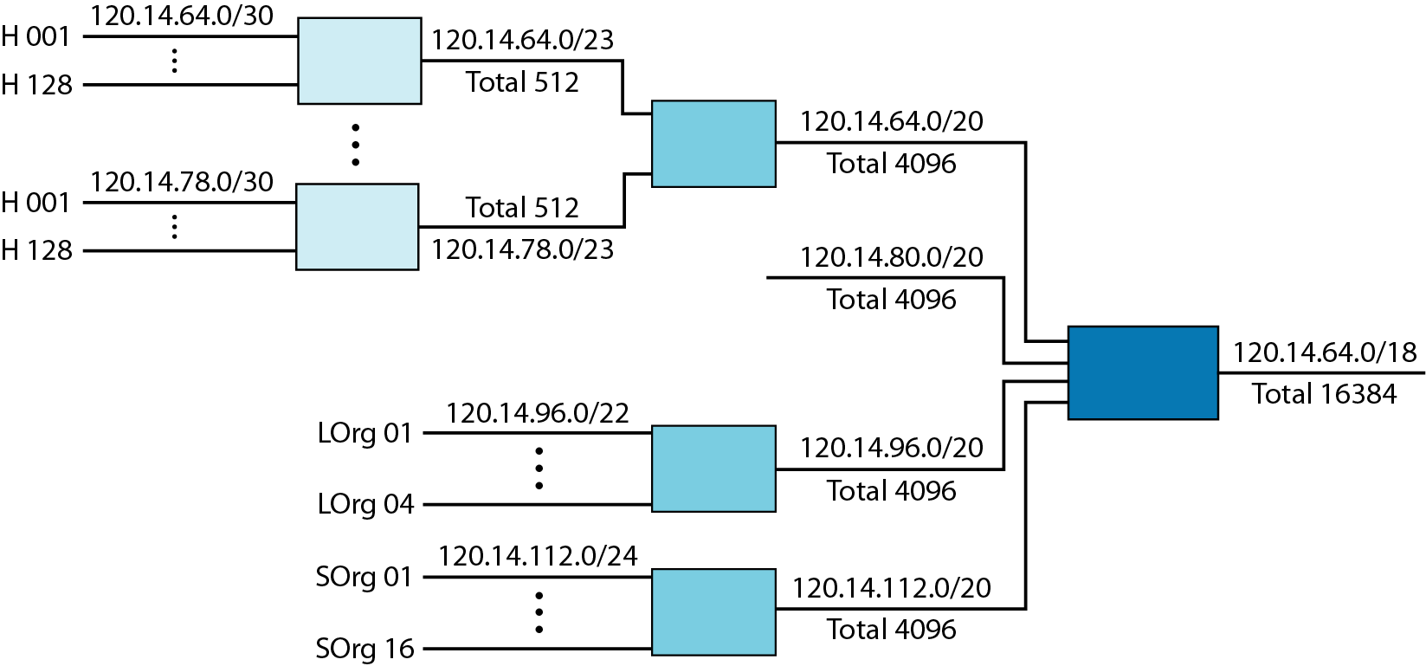
Figure 22.9 Hierarchical routing with ISPs

Slide 29
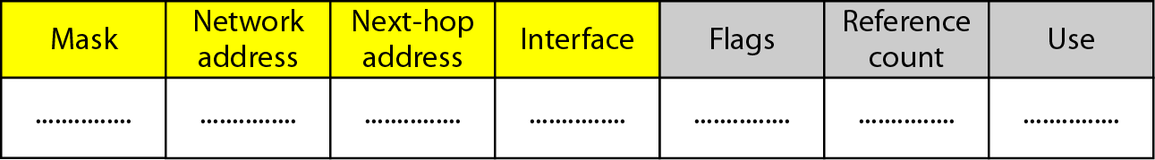
Figure 22.10 Common fields in a routing table

Slide 30
Example 22.6
One utility that can be used to find the contents of a routing table for a host or router is netstat in UNIX or LINUX. The next slide shows the list of the contents of a default server. We have used two options, r and n. The option r indicates that we are interested in the routing table, and the option n indicates that we are looking for numeric addresses. Note that this is a routing table for a host, not a router. Although we discussed the routing table for a router throughout the chapter, a host also needs a routing table.

Slide 31
Example 22.6 (continued)
The destination column here defines the network address. The term gateway used by UNIX is synonymous with router. This column actually defines the address of the next hop. The value 0.0.0.0 shows that the delivery is direct. The last entry has a flag of G, which means that the destination can be reached through a router (default router). The Iface defines the interface.

Slide 32
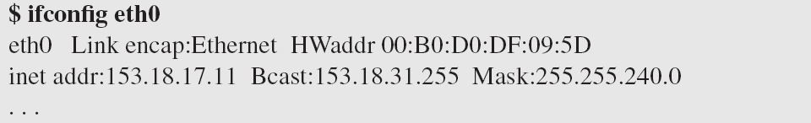
Example 22.6 (continued)
More information about the IP address and physical address of the server can be found by using the ifconfig command on the given interface (eth0).

Slide 33
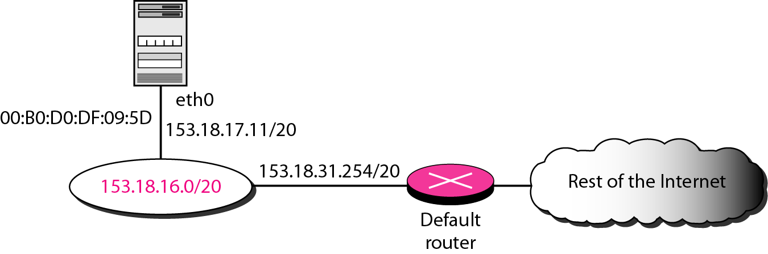
Figure 22.11 Configuration of the server for Example 22.6

Slide 34
22-3 UNICAST ROUTING PROTOCOLS
A routing table can be either static or dynamic. A static table is one with manual entries. A dynamic table is one that is updated automatically when there is a change somewhere in the Internet. A routing protocol is a combination of rules and procedures that lets routers in the Internet inform each other of changes.
Topics discussed in this section:
Optimization Intra- and Interdomain Routing
Distance Vector Routing and RIP
Link State Routing and OSPF
Path Vector Routing and BGP

Slide 35
An autonomous system is a group of networks and routers under the authority of a single administration.
Routing inside an autonomous system is referred to as intradomain routing
Routing between autonomous systems is referred to as interdomain routing

Slide 36
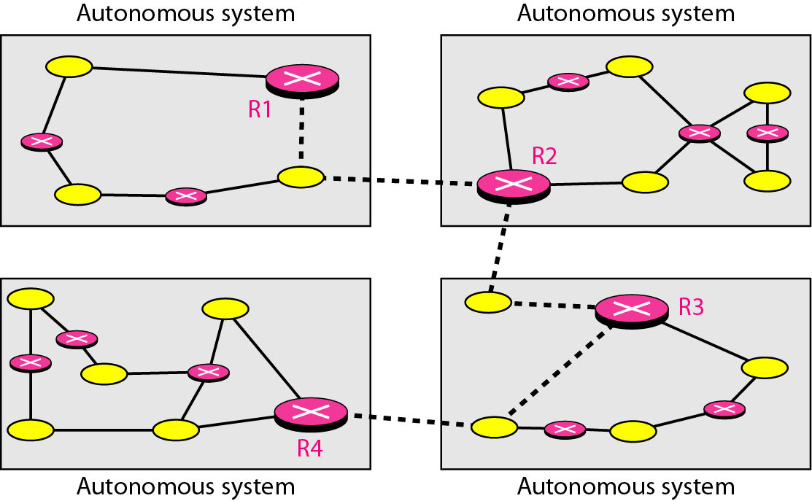
Figure 22.12 Autonomous systems

Slide 37
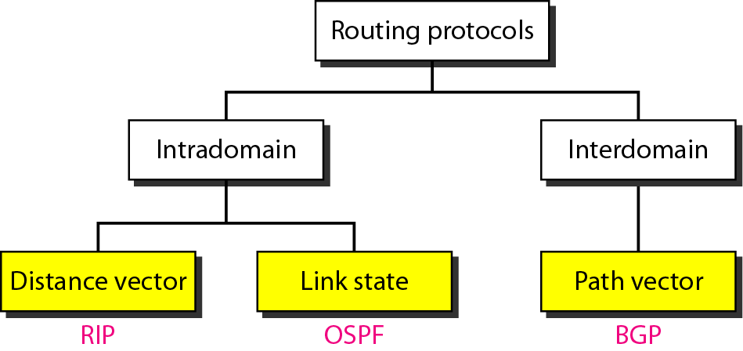
Figure 22.13 Popular routing protocols

Slide 38
Distance Vector Routing
The least-cost route between any two nodes is the route with minimum distance
Each node maintains a vector (table) of minimum distances to every node
The table also guides packets to the desired node by showing the next hop

Slide 39
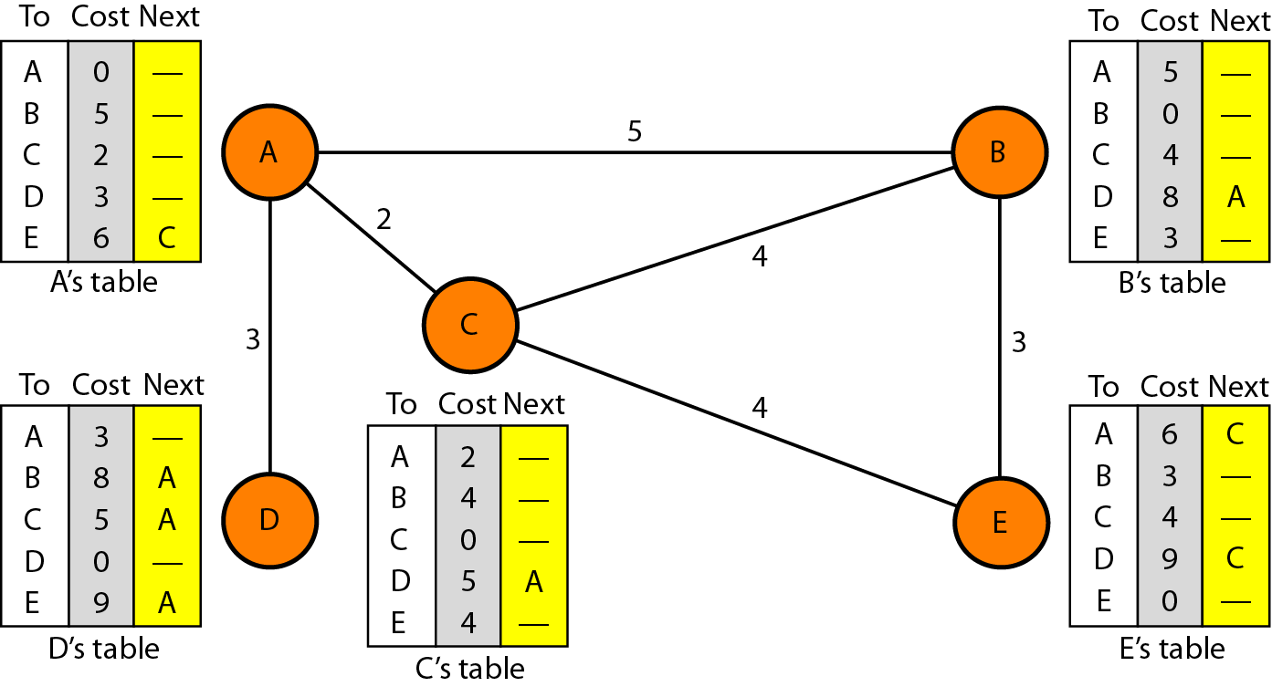
Figure 22.14 Distance vector routing tables

Slide 40
Initialization
Each node knows the distance from itself to it’s immediate neighbors
All other distances are set to infinity
Next hops are left blank

Slide 41
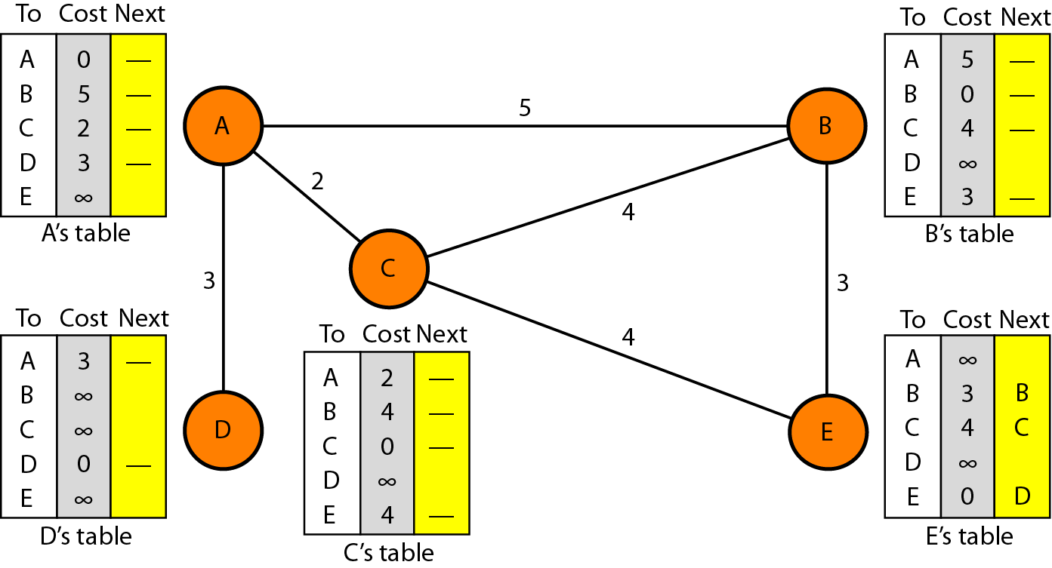
Figure 22.15 Initialization of tables in distance vector routing

Slide 42
Note
In distance vector routing, each node shares its routing table with its
immediate neighbors periodically and when there is a change.

Slide 43
Sharing
Nodes send their routing tables to the other nodes
Each node can then update their tables to provide the distance and the next hop required to reach any other node
When a node (e.g. A) receives a table from another node (e.g. node C) it then computes the cost to each node which is the sum of the cost to get to node C and the cost in node C’s table
The result is compared to the original values in the router table for node A and the minimum is used
Where ever the router table is updated with a new value the “Next” column contains the router it came from

Slide 44
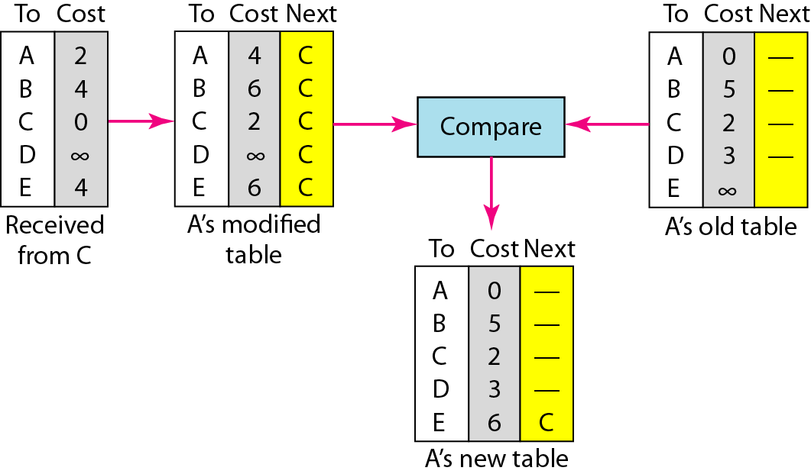
Figure 22.16 Updating in distance vector routing

Slide 45
Two-Node Loop Instability
It is possible that vector routing can result in instability
If a system is using triggered updates (i.e. when a change occurs the node sends out it’s new table) the result shown in fig 22.17 can occur
This results when Node B sends A it’s new table BEFORE Node A has a chance to send it’s new table (with X now unreachable) to Node B. Node A will think B has a way to reach X
Although over time the system stabilizes the result can be a set of tables that send a packet destine for Node X from A to go to Node B and vise-versa

Slide 46
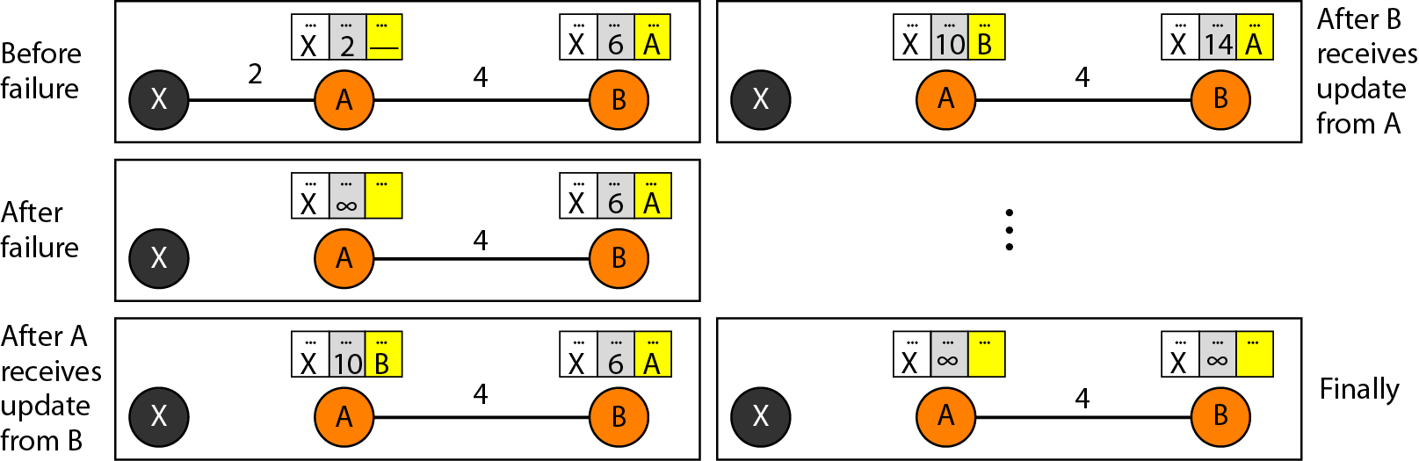
Figure 22.17 Two-node instability

Slide 47
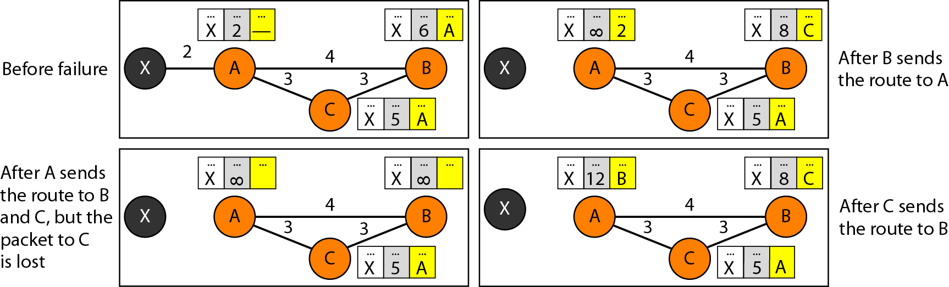
Figure 22.18 Three-node instability

Slide 48
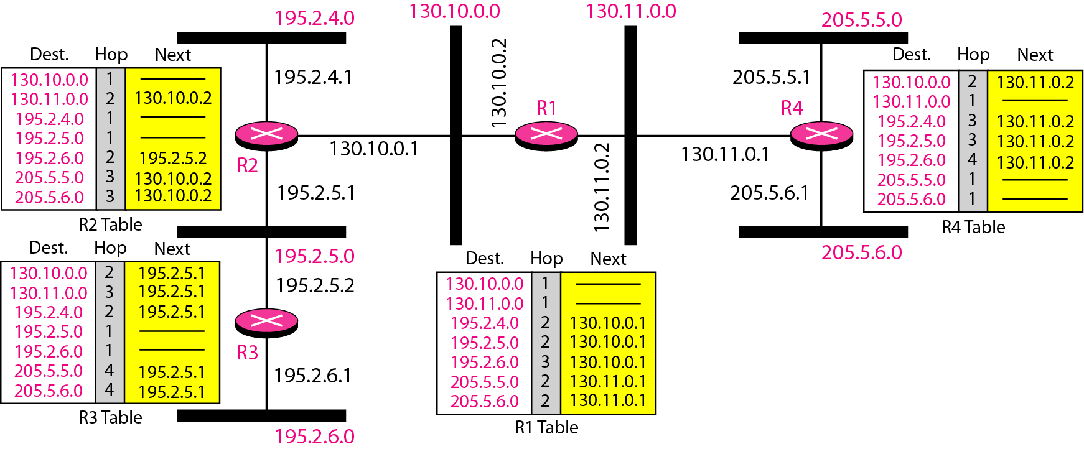
Figure 22.19 Example of a domain using RIP

Slide 49
Link State Routing
Each node is aware of the entire topology of the domain
Each node uses Dijkstra’s algorithm to build it’s routing table
Topologies must be kept updated – if a change occurs the routing table needs to be updated
Topologies are determined from the information found at the other nodes

Slide 50
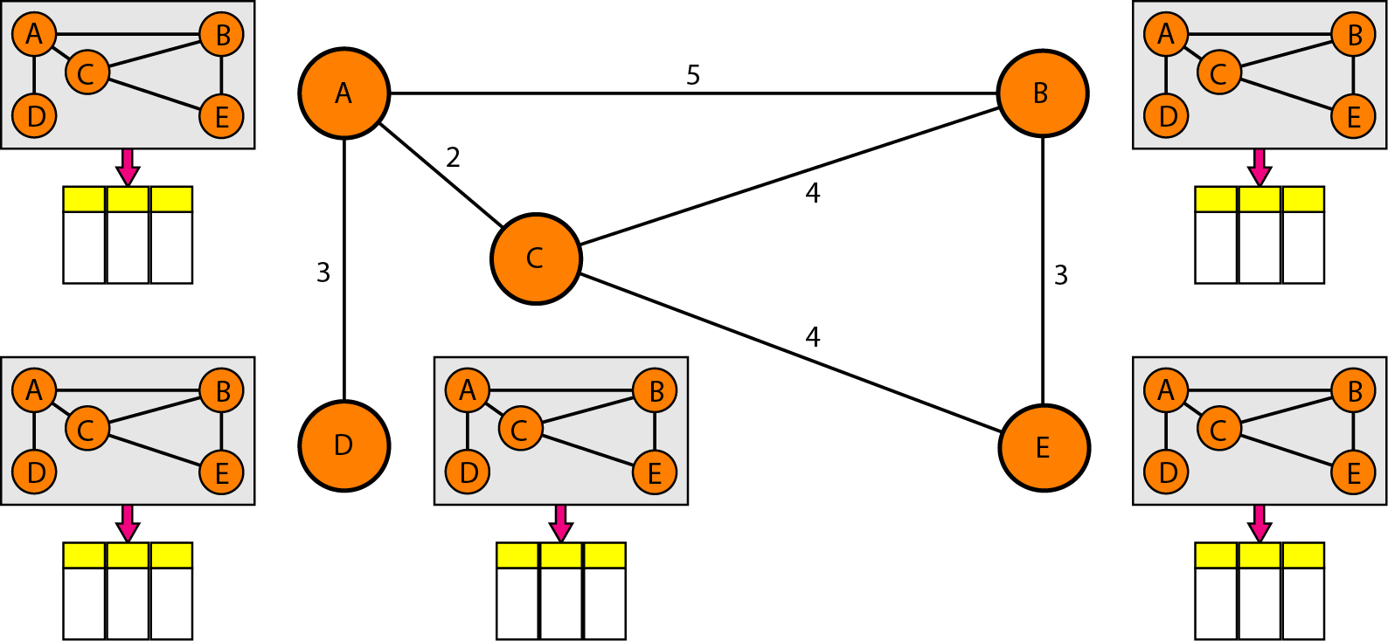
Figure 22.20 Concept of link state routing

Slide 51
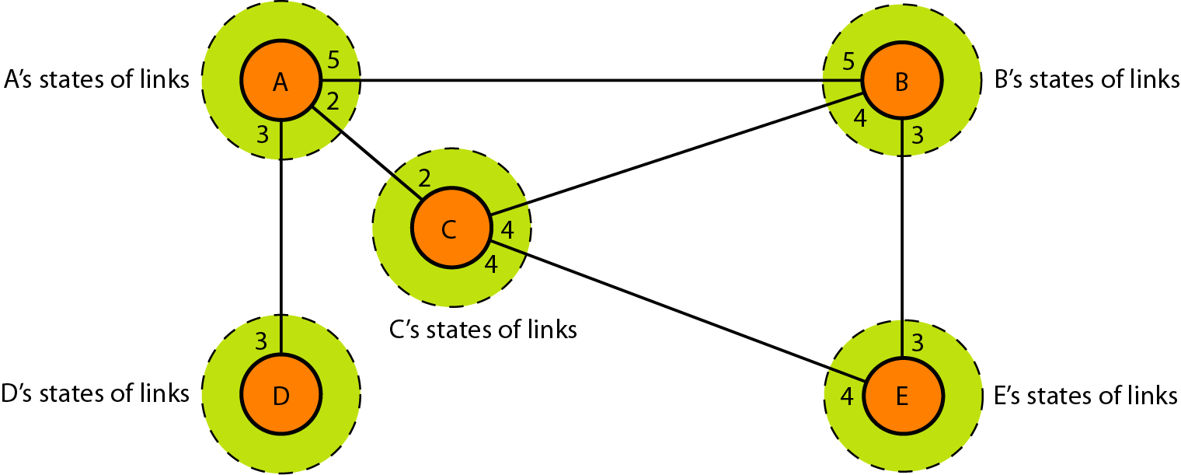
Figure 22.21 Link state knowledge

Slide 52
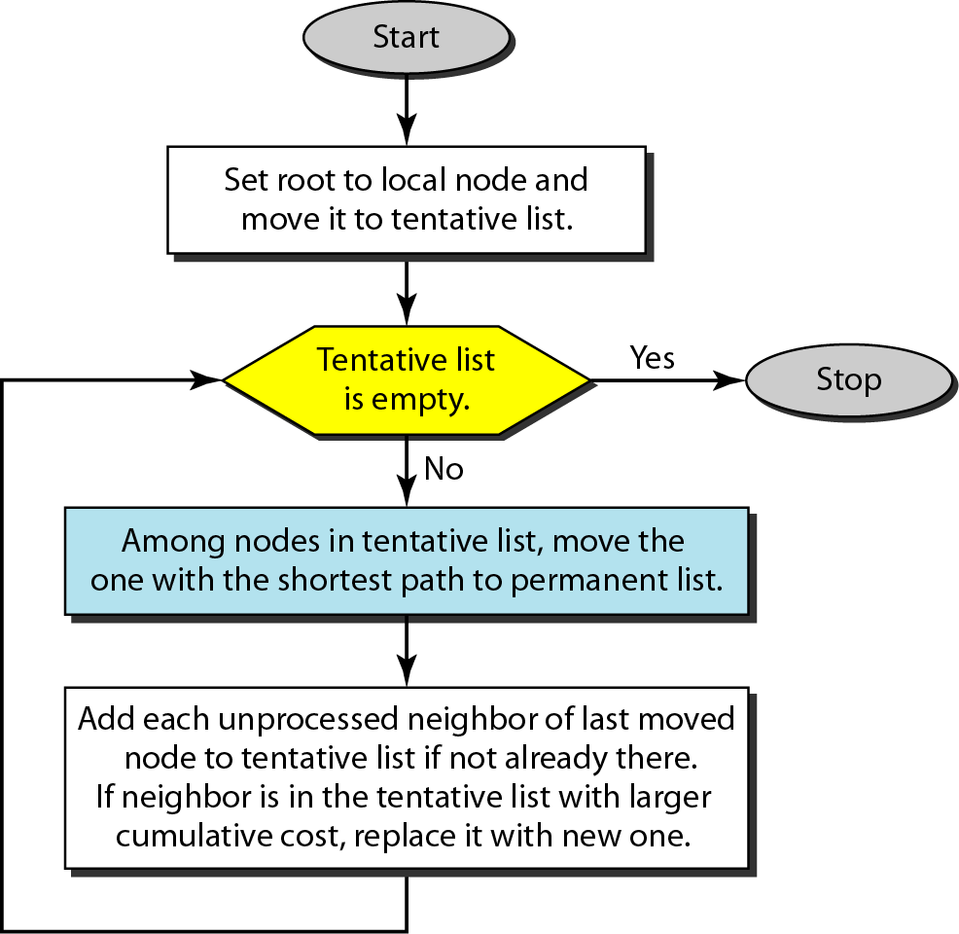
Figure 22.22 Dijkstra algorithm

Slide 53
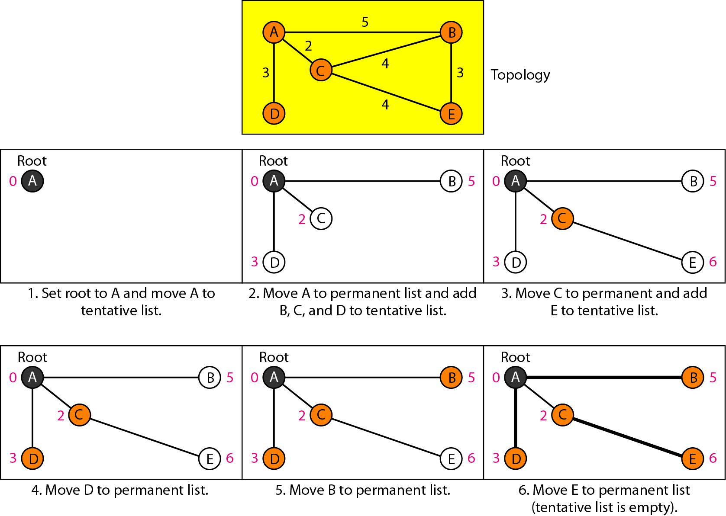
Figure 22.23 Example of formation of shortest path tree

Slide 54
Repeat the above example but set the link between C and B to have weight 3, the link between C and E to have weight 1, the link between A and C to have weight 1, and the link between E and B to have weight 1 and the link between A and B to have weight 6

Slide 55
Table 22.2 Routing table for node A

Slide 56
Path Vector Routing
Used in interdomain routing i.e. between autonomous systems
Similar to distance vector routing but assume that an autonomous system is one node (speaker node) that acts on behalf of the entire autonomous system
The speaker node then sends it’s routing table to the other speaker nodes for updating in the same fashion as in distance vector routing

Slide 57
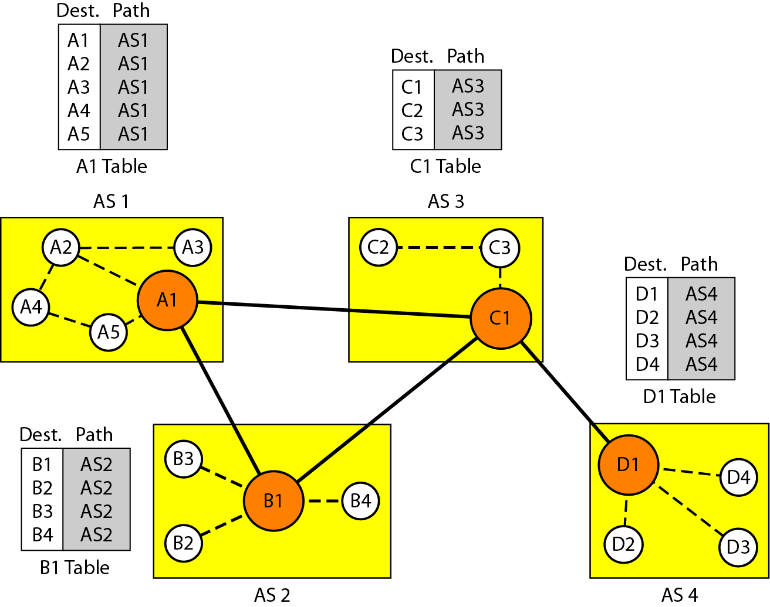
Figure 22.30 Initial routing tables in path vector routing

Slide 58
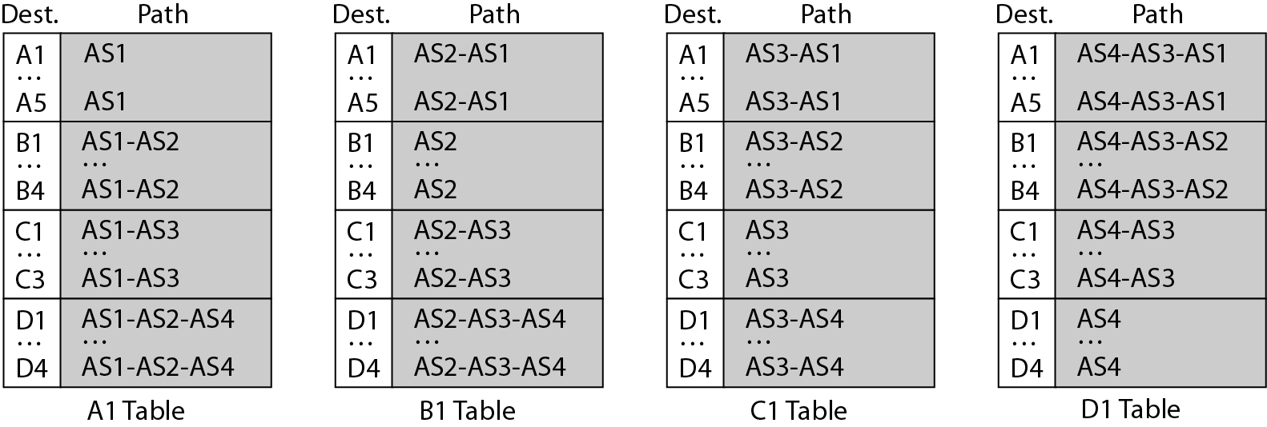
Figure 22.31 Stabilized tables for three autonomous systems

Slide 59
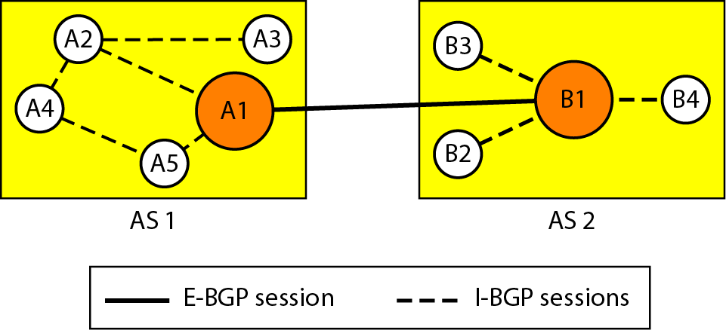
Figure 22.32 Internal and external BGP sessions

